Slide 1
Life Expectancy: Alchohol consumption increases life expectancy?
Group 9: Fangchen Wang, Emma Zurstrassen, Jason Huang, Aneeka Agarwal, Vanshika Bhatia, Alberic Teisseire

Slide 2
Data Source
Gapminder dataset
World Bank’s health nutrition and population statistics
The world bank’s life expectancy dataset

Slide 3
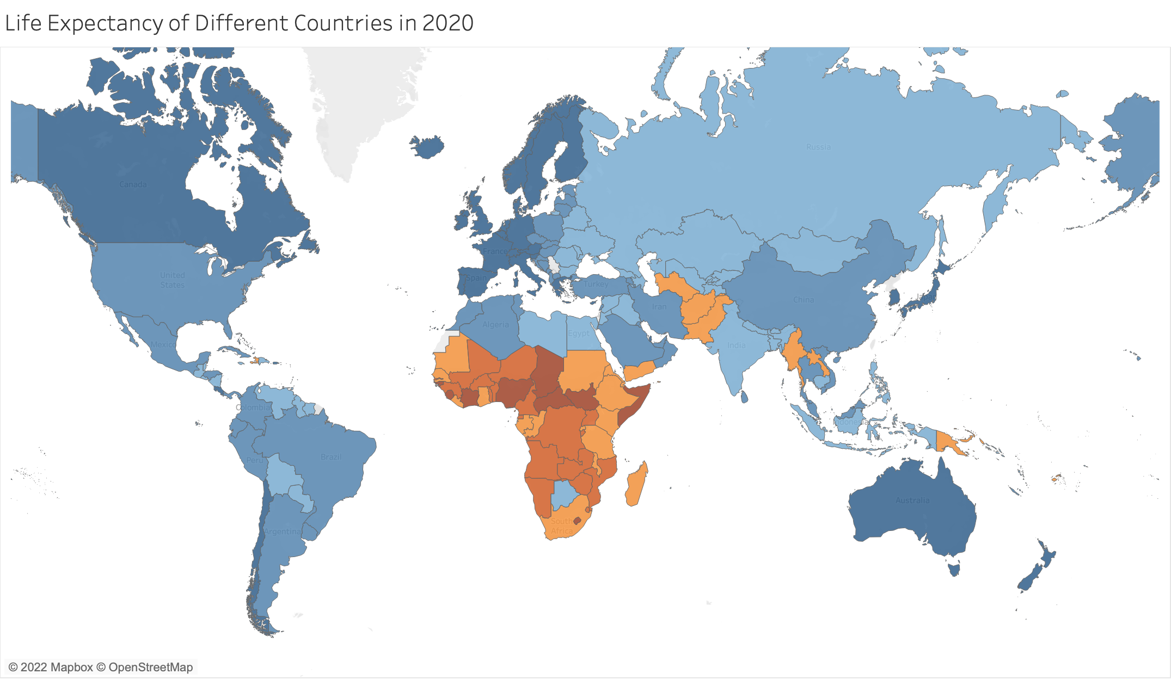
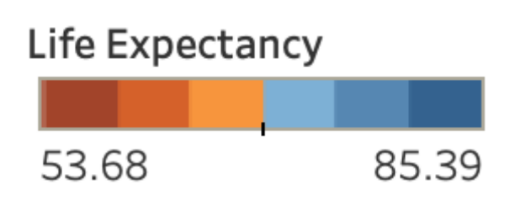
Life Expectancy of Different Countries in 2020
There is a clear difference in life expectancy around the globe, with Europe and North America higher than the rest of the world, and Africa lower than average.

Slide 4
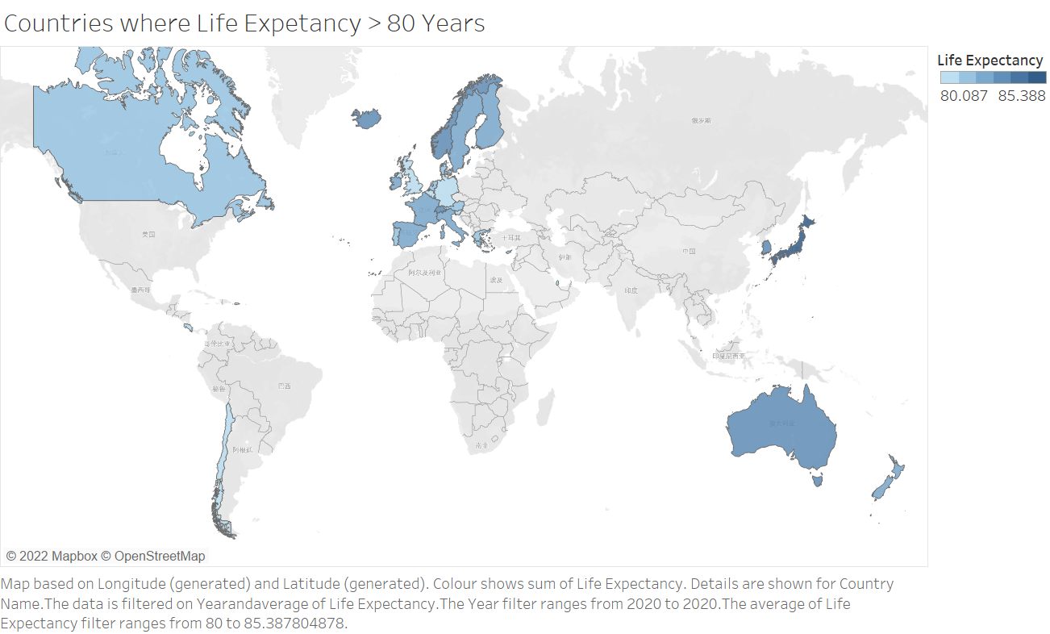

Slide 5
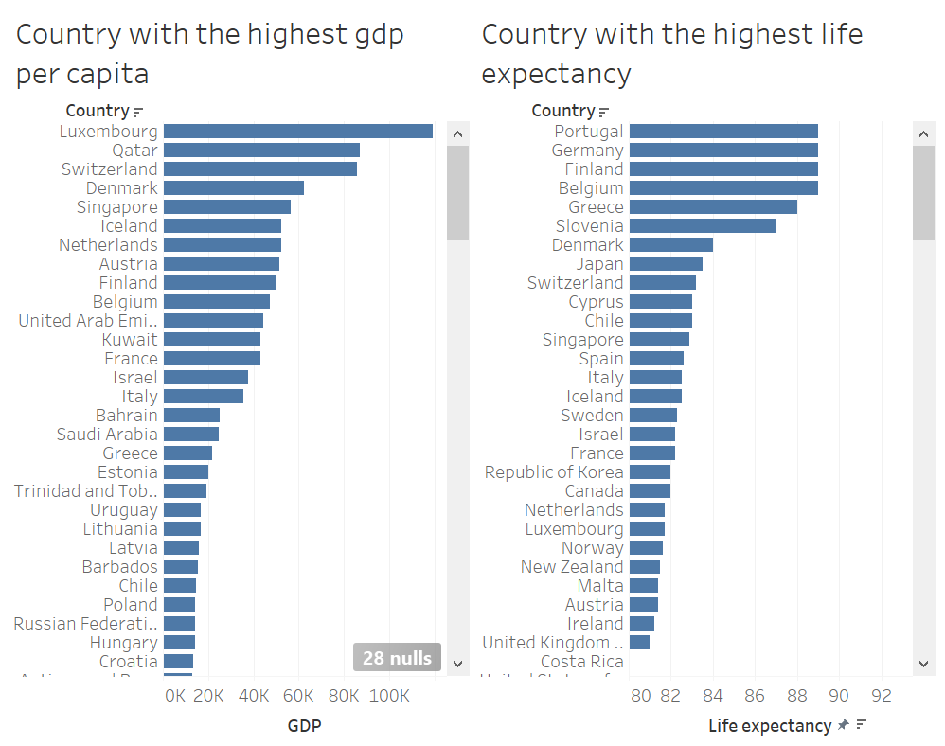

Slide 6
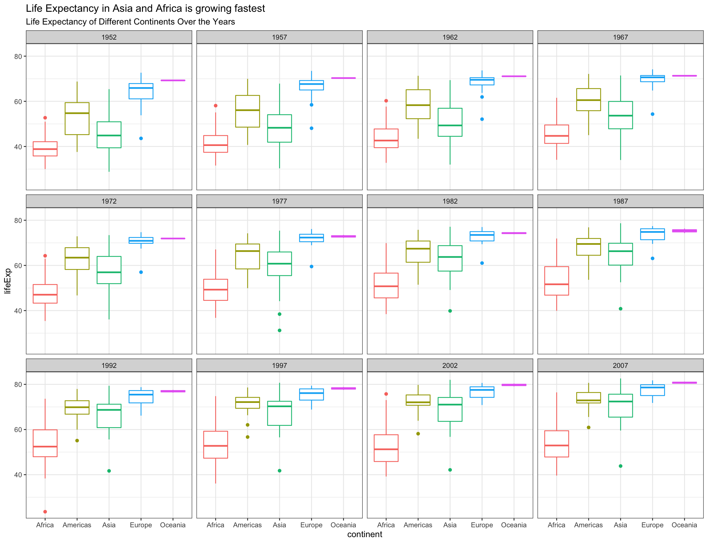
According to the boxplot over the years, we found that life expectancy in different continents has changed over time, with Africa and Asia showing a significant increase, while the number of the rest of the world increase steadily.

Slide 7
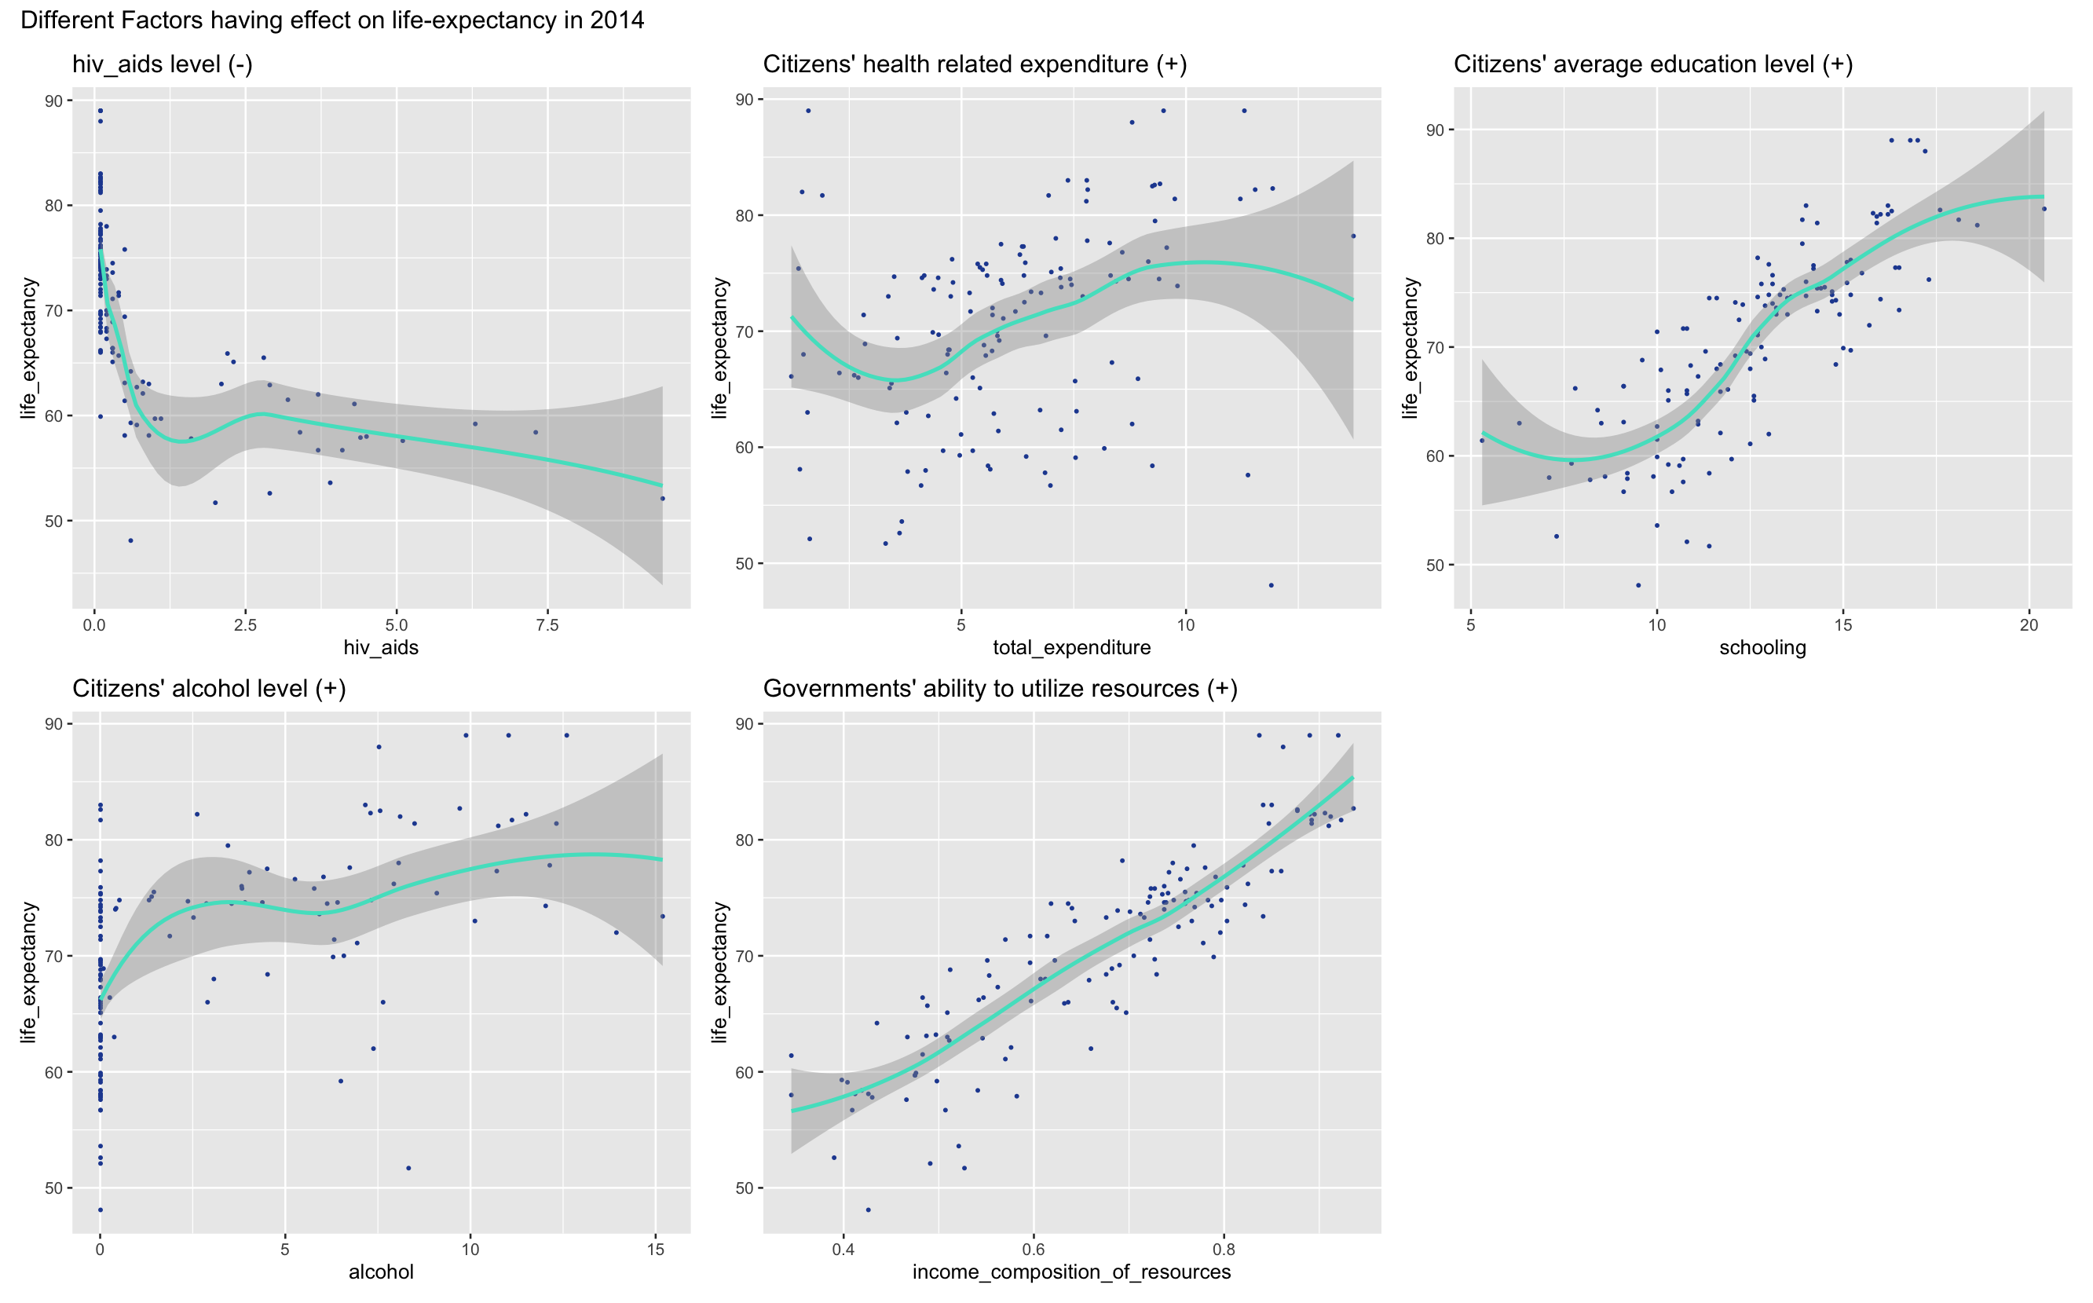
Different Factors having effect on life-expectancy in 2014
Based on multi-variable linear regression result, we can see that, in 2014, Income Composition of Resources, and HIV rate significantly impacts the average life expectancy in a particular country. （We left out Adult Mortality to avoid perfect fit problem)

Slide 8
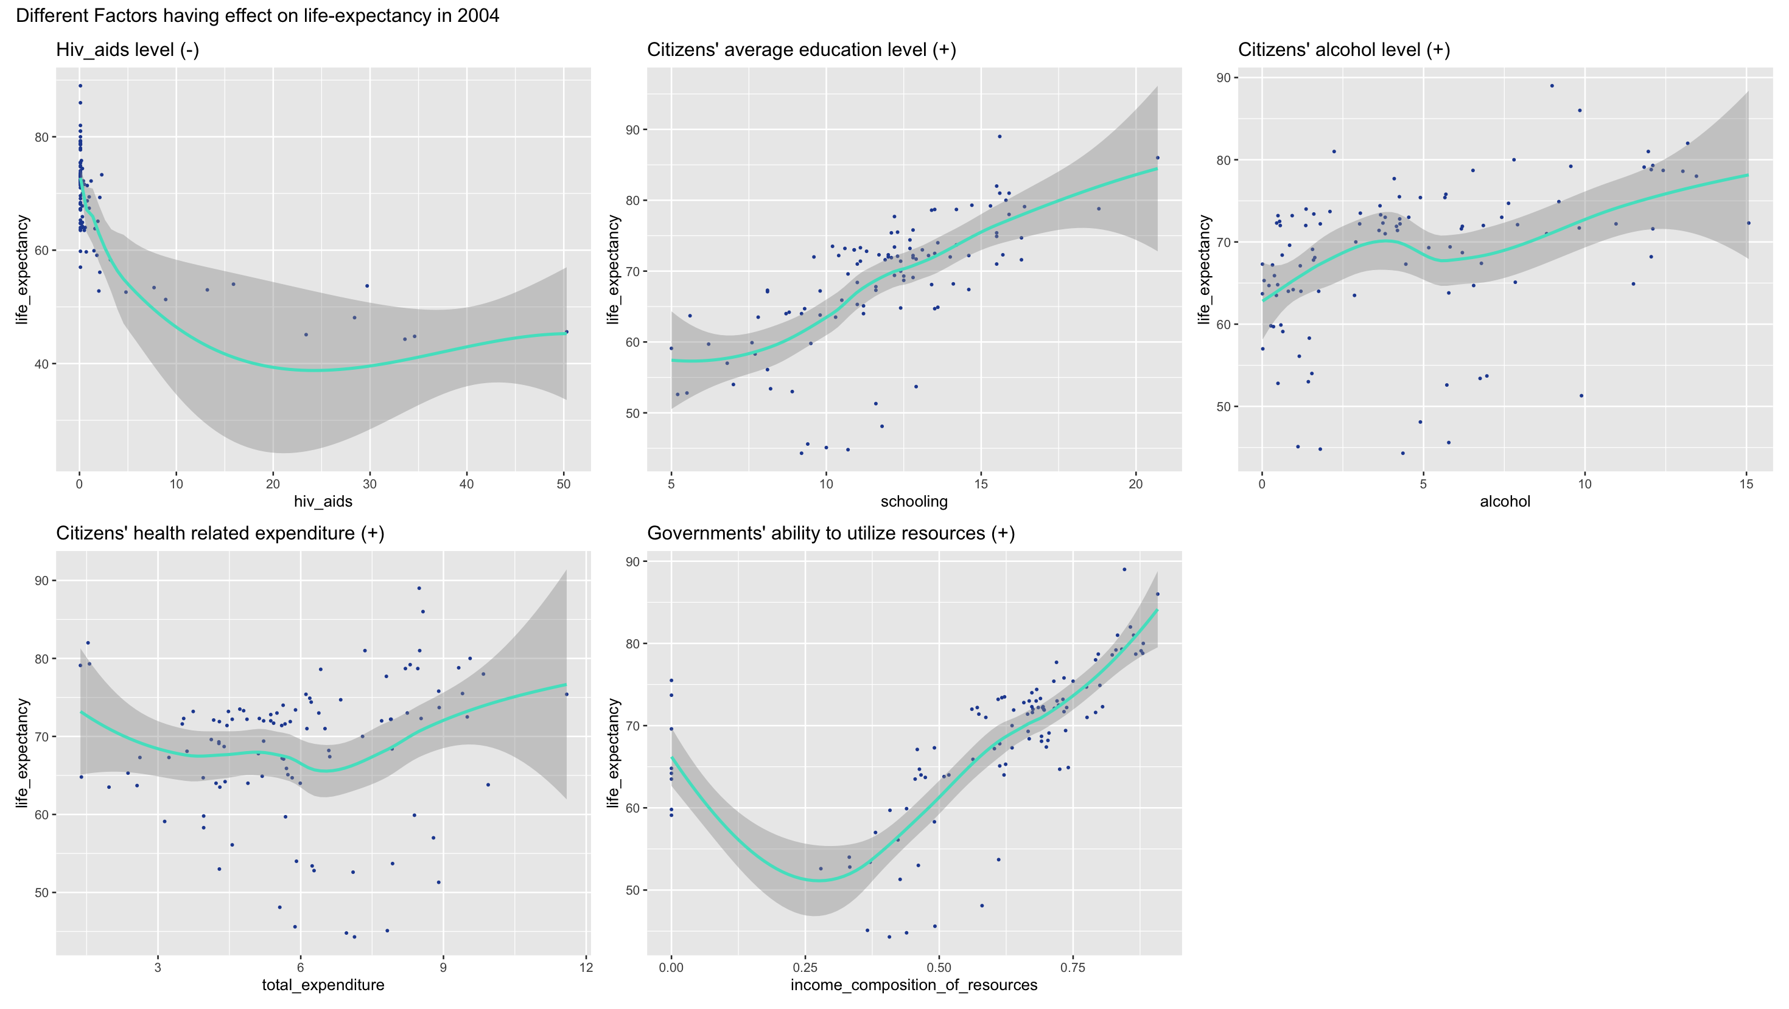
Different Factors having effect on life-expectancy in 2004
However, when we run multi-variable linear regression on year 2004 dataset, we can see that, in 2004, Income Composition of Resources no longer has an impact on life expectancy. In its place, Schooling (education level), HIV rate, and under-five deaths are significantly impacting average life expectancy in a country.

Slide 9
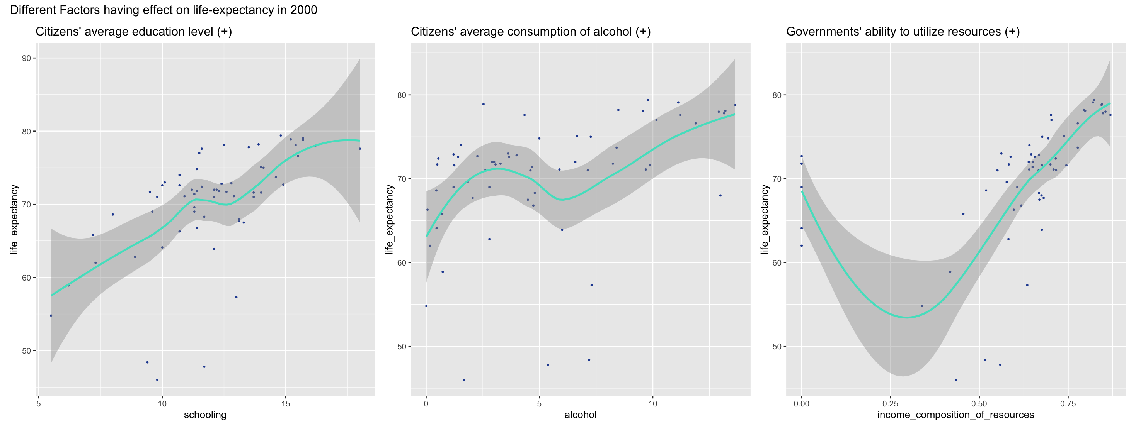
Different Factors having effect on life-expectancy in 2000
Based on the multi-variable regression result and its visualization, we’ve noticed two interesting and counter-intuitive facts.
(1). Citizens’ average alcohol consumption is positively impacting life expectancy in this country. We propose the theory that this is because alcohol can (a) improve cardiovascular health, (b) improve individuals’ emotion, (c) indicate that these people are well financially.
(2). Countries’ GDP level is not significantly affecting this country’s average life expectancy. We think it’s because of potential outliers and will do further analysis in the next part.

Slide 10
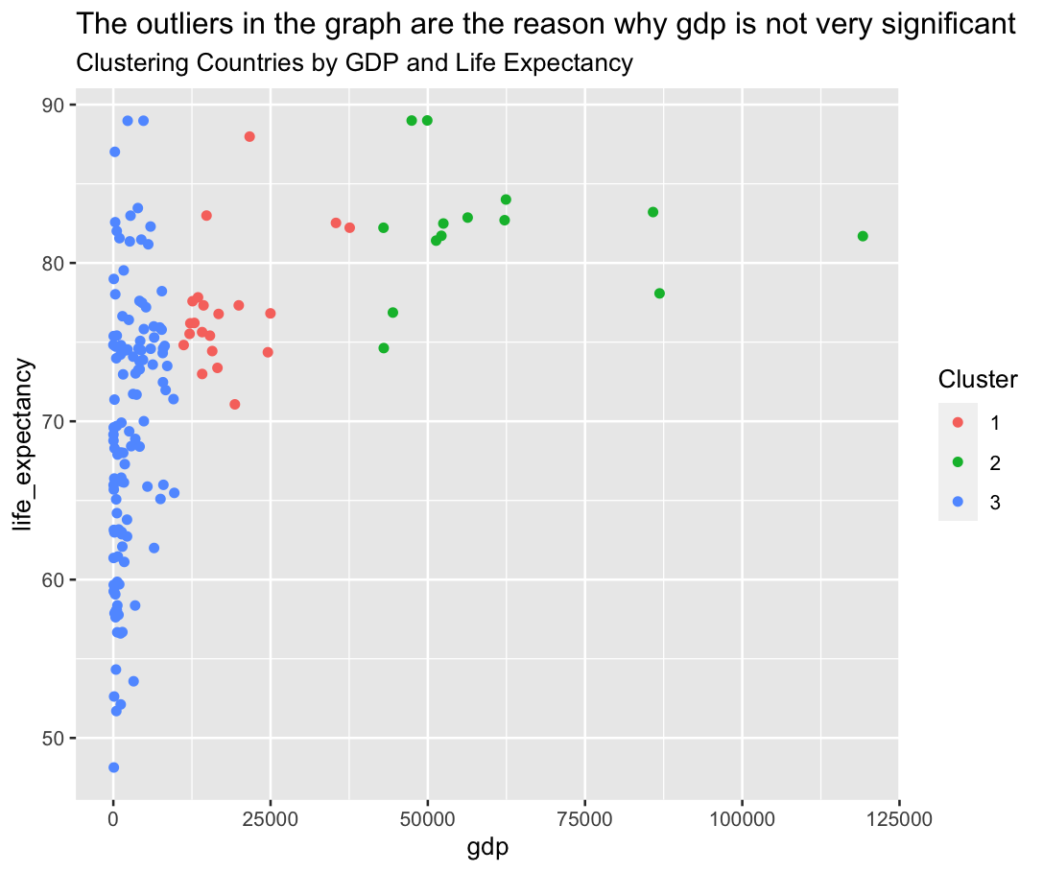
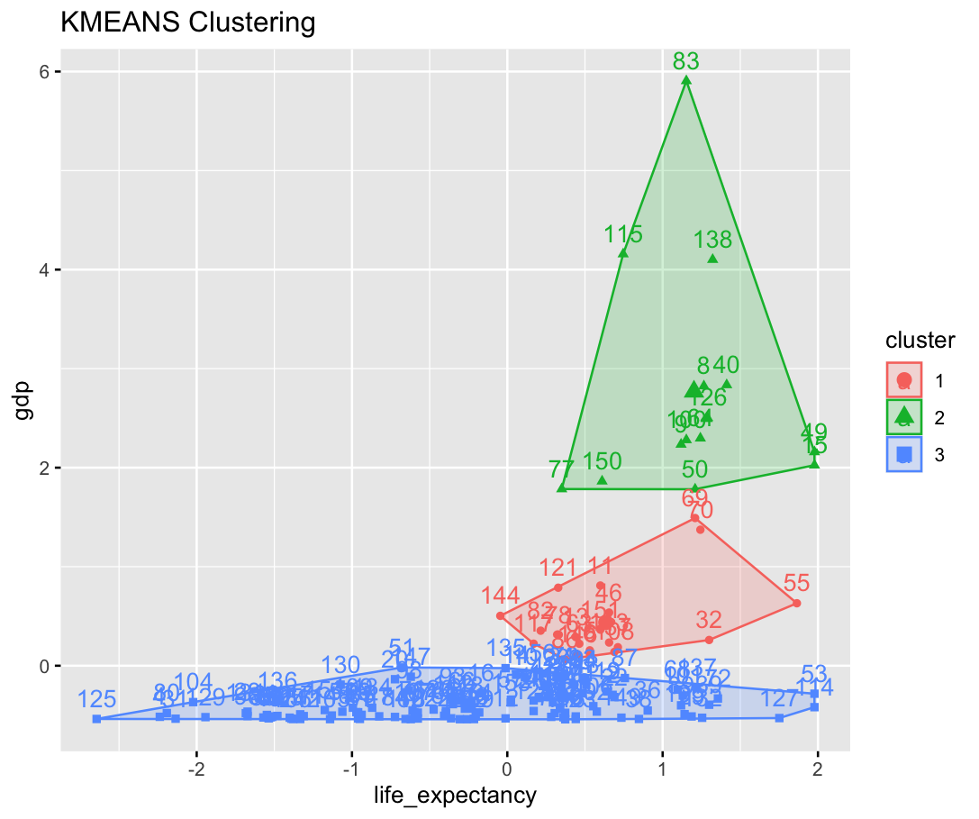
Using kmeans method, we can tell that there are three groups of countries: a) countries with low gdp and lower life expectancy; b) countries with median gdp and higher life expectancy; c) countries with high gdp and high life expectancy. However, there are outliers in the (a) group. Citizens in some countries have high life expectancy despite low gdp. After examining these countries, we found that they are exercising a healthier life style. Maybe that’s the reason why gdp is not significant in the regression models.

